Slide 1
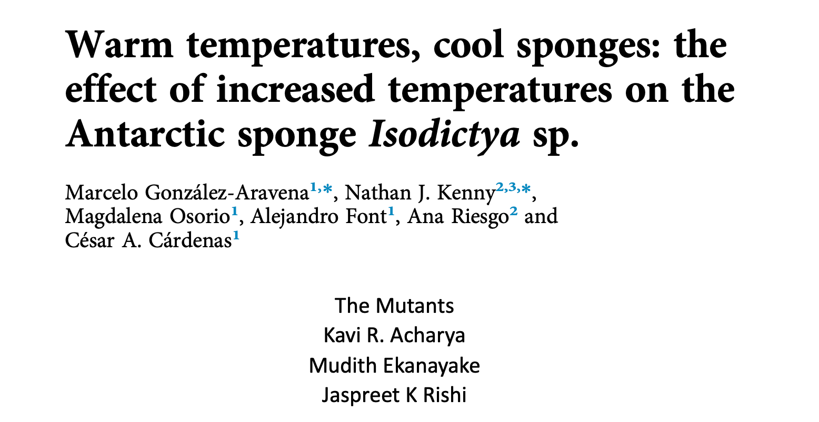

Slide 2
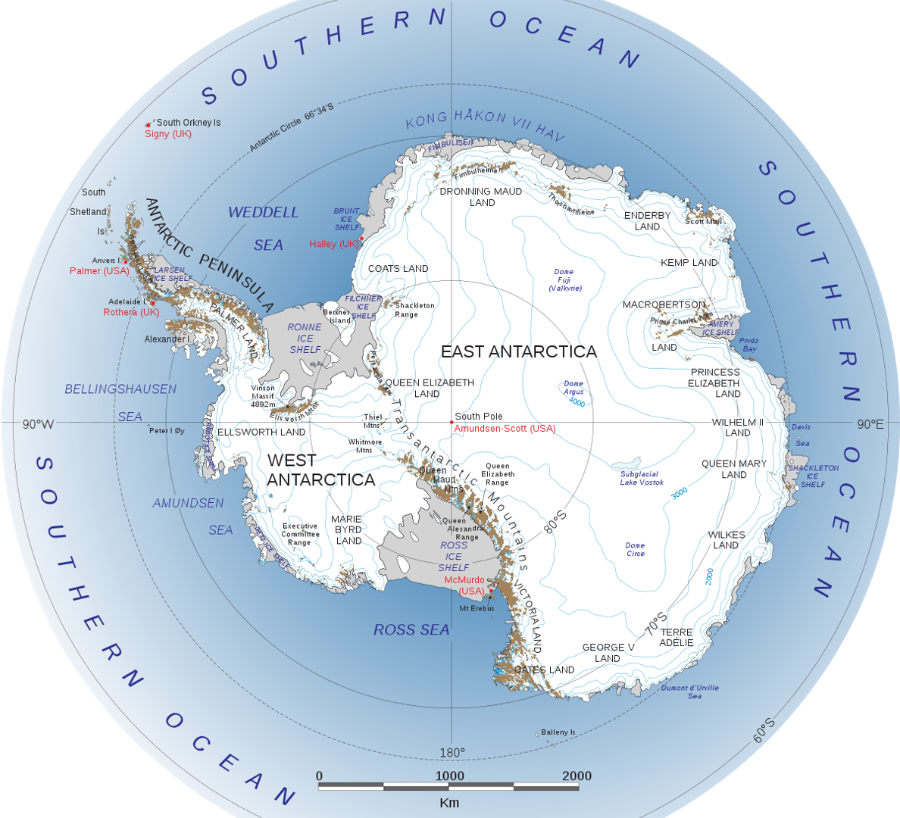
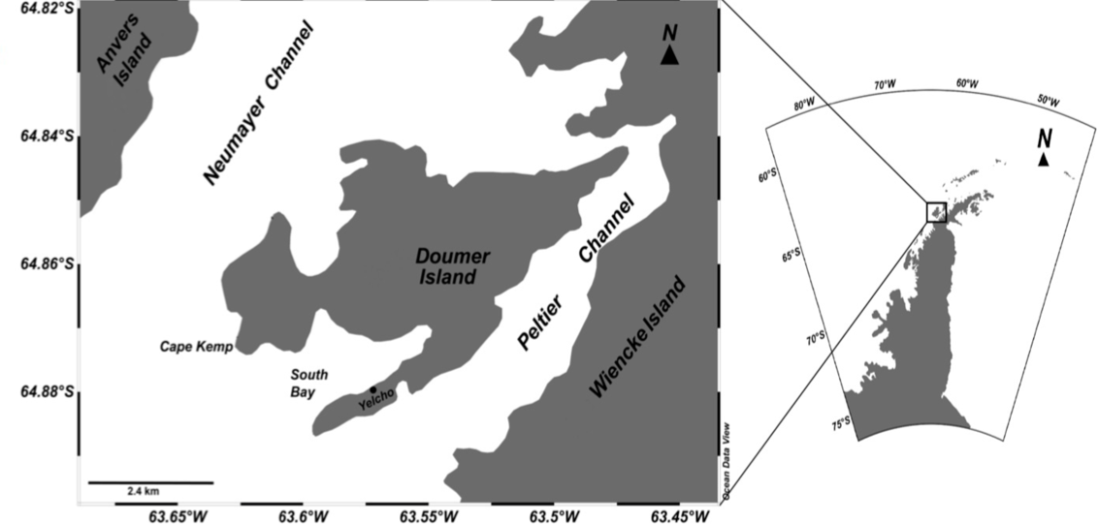
Western Antarctic Peninsula
Notes:
Although the cellular and molecular responses to exposure to relatively high temperatures (acute thermal stress or heat shock) have been studied previously, only sparse empirical evidence of how it affects cold-water species is available. Current estimates of climate change in the Antarctic suggest that the mean temperature of seawater could rise by about 0.6 C (Representative Concentration Pathway 2.6) to 2.0 C . Antarctic-dwelling species may be particularly vulnerable due to their specialisation for extremely cold, relatively stable temperature conditions. This picture of the globe represents the antarctic peninsula. For this study, a sponge, Isodictya, samples were collected from the around Doumer Island, Palmer Archipelago,western Antarctic Peninsula

Slide 3
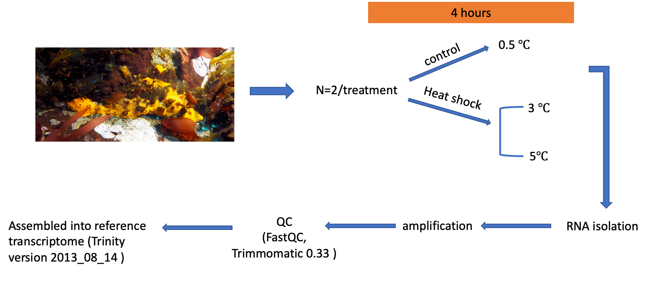
Study Design
2080 IPCC-SRES
(DeconSeq version 0.4.3)
Notes:
6 samples from adult isodyctia were collected from 10m deep to understand whether this organism can adjust to acute short-term heat stress, by exposing this species to 3 and 5 C for 4 h, Control group was maintained at 0.5 deg. There was an N of 2 for each treatment. The temperatures corresponded to predicted temperatures under high-end 2080 IPCC-SRES scenarios. Ipcc-SRES-intergovernmental Panel on Climate Change Special Report on Emissions Scenarios
After 4 hours of exposure, RNA was extracted from each sample and amplified used ILLUmina sequencing . adapter sequences were removed and overall quality of the sequences were tested using Fast QC and one low quality control was removed. Low-quality regions of reads were trimmed using Trimmomatic 0.33.
Clustering of isoforms was performed natively by Trinity. DeconSeq was used to remove contamination using pre-prepared bacterial, archean and viral databases), resulting in the final reference assembly.

Slide 4
Methods
Animal collection and heat treatment
RNA extraction and sequencing
Quality control and assembly
Phylogenetic analysis
Transcriptome analysis and annotation
Differential expression analysis and over-representation analysis

Slide 5
Differential expression analysis
Comparative analyses of gene expression
RSEM
Cross-compare
edgeR
Excluding differentially expressed contigs due to spurious results
Manipulation of the data
R
Generating the heatmaps
R

Slide 6
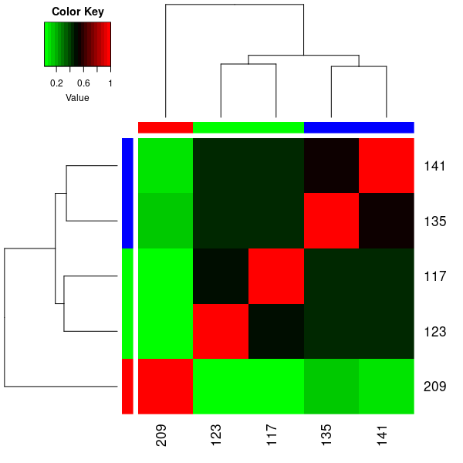
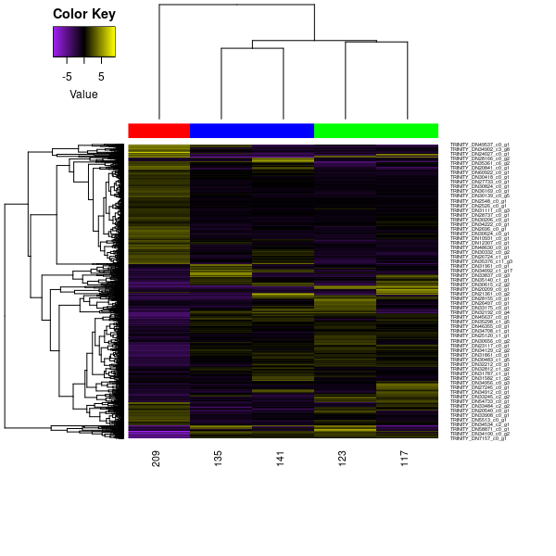

Slide 7
Phylogenetic analysis
HSP70 sequence extraction
BLASTN
R
Alignment to previously published sequences
MAFFT
R
Curating the HSP70 gene alignments
Gblocks
R
Phylogenetic reconstruction
RAxML-NG
Packages Used
ape
phangorn
phytools
geiger
Phylogenetic and molecular evolutionary analyses
MEGA
Inferring the tree using the NJ method
ClustalW

Slide 8
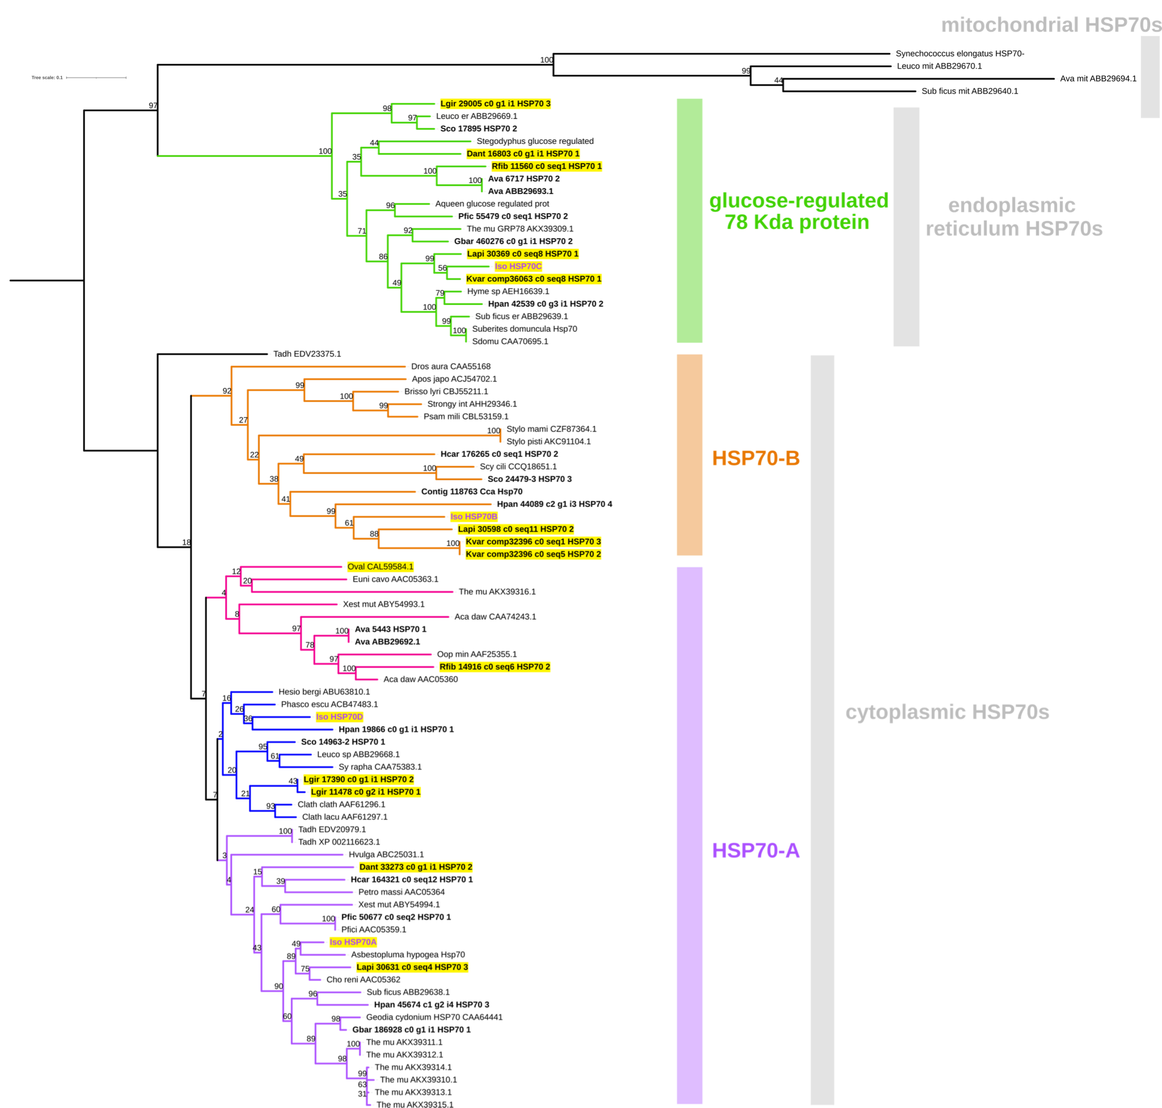

Slide 9
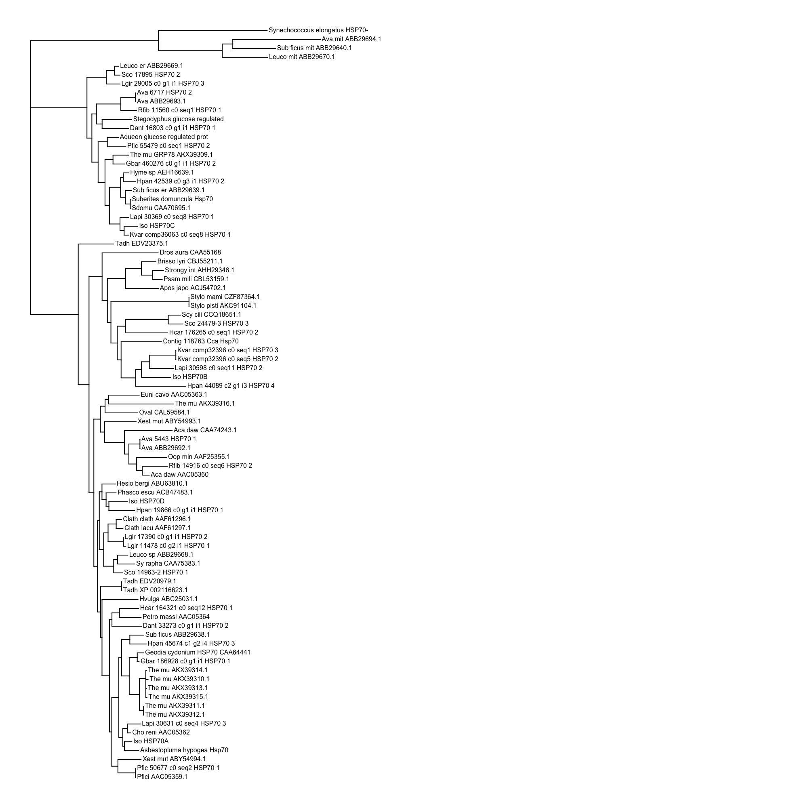
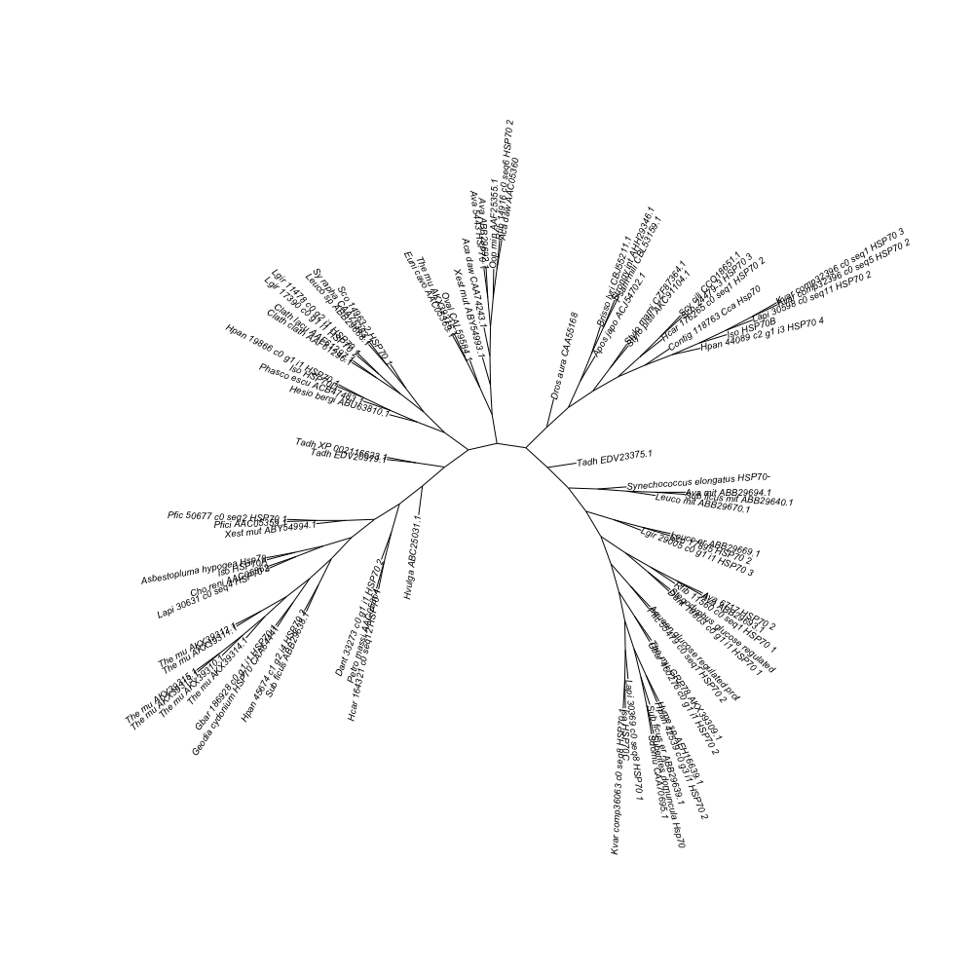

Slide 10

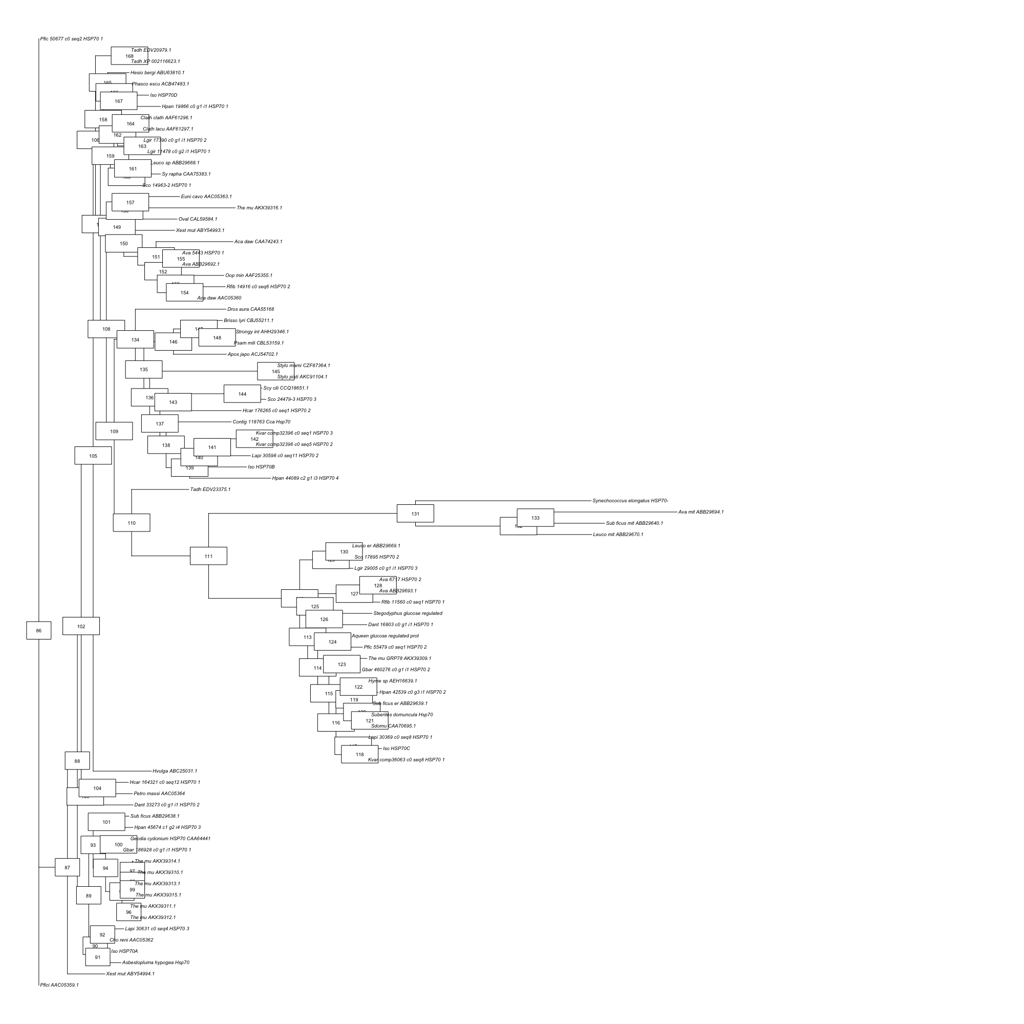

Slide 11
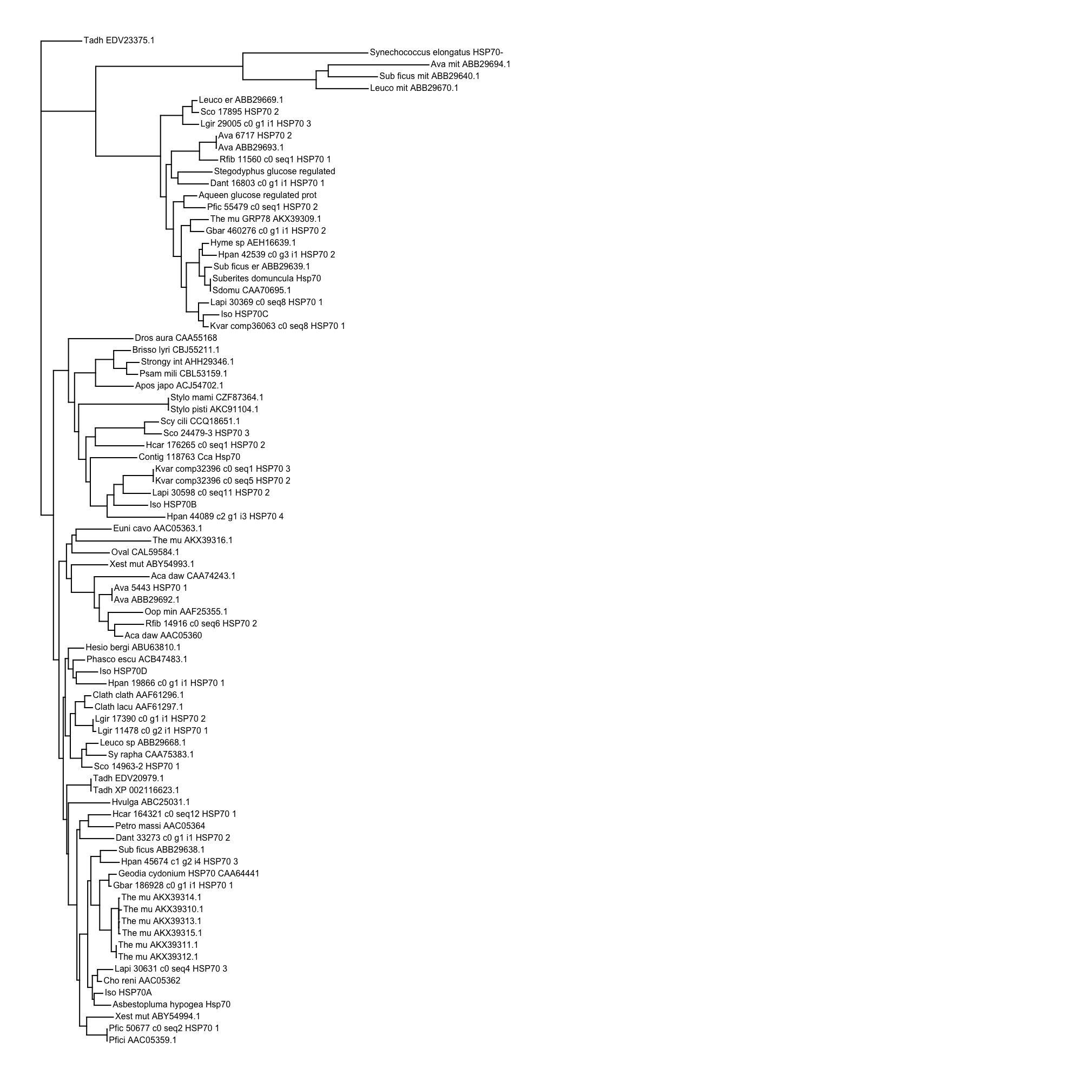

Slide 12
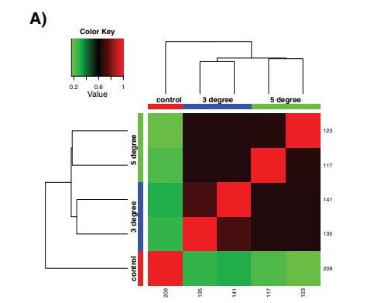
Sample correlation matrix for the five samples used in the final cross-comparison
González-Aravena​, M. et al 2019
Notes:
Clusters formed between replicates (by the long branches) shows within sample variation. Similarly, there is little variation between treatments (small distances between nodes leading to the individual replicates)
We were able to replicate the within samples variation however between treatments does look little different.
Black boxes- similarity
Green- 5 degrees treatment

Slide 13
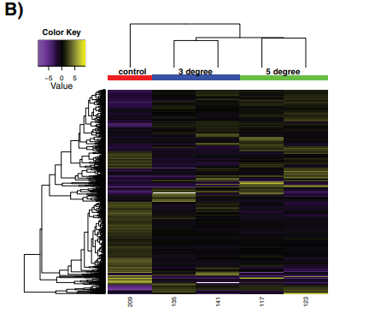
Relative expression of each differentially expressed contig across all the samples
González-Aravena​, Marcelo, et al. 2019
Notes:
Black hues showing few measurable difference between samples
Contigs- rows, samples- columns
If they used any specific gene cluster, we could not figure it out
There were some discreet intersample variation. Large downregulated quadrant around samples compared to the control.

Slide 14
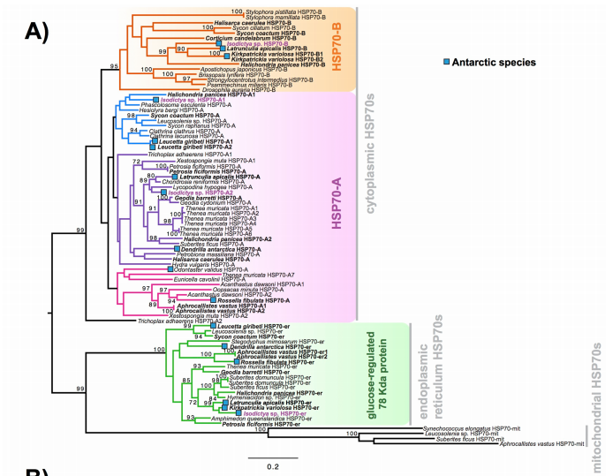
Maximum likelihood-derived phylogeny of HSP70 sequences
González-Aravena​, Marcelo, et al. 2019
Notes:
Strong indication of HSP70 A and B are ancestrally shared paralogues within porifera.
Using RAxML, LG+I+G
Isodictya sequences- highlighted (yellow-purple)

Slide 15
Conclusions
3-5 degree increase showed little change in response indicating even a little increase in temperature can alter the response and cause stress.
Findings corroborated with previous conclusions regarding the transcriptomic response to acute thermal stress, while suggesting specifically that cold adapted sponges may have a limited range of tolerance to increased temperatures.
Notes:
It may be possible that with a period of acclimation, sequential rises in temperature can be met by successive rounds of molecular adaptation.
Acute exposure, number of replicates is too less.

